Slide 1

Classes, Interfaces and Enums

Slide 2
Agenda
After this session, you will know
Classes
Interfaces
enum

Slide 3
Java - Classes
What is Class?
Class − A class can be defined as a template/blueprint that describes the behaviour/state that the object of its type support.
public class Library {
String name;
int totalNumberOfBooks;
public void rentBook(Book book) {
} public void returnBook(Book book) {
}
}
class Book {
String name;
double price;
}
Notes:
semester2\1-java8\1-coding-fundamentals-oops-control-statements\2-class-exercises-and-demos\coding-fundamentals\src\com\imarticus\tutorial\codingfundamentals\demos\classinterfaces\section1\Library.java

Slide 4
Java - Classes
Classes – Variable Types
A class can contain any of the following variable types.
Local variables − Variables defined inside methods, constructors or blocks are called local variables.
The variable will be declared and initialized within the method and the variable will be destroyed when the method has completed.
Instance variables − variables within a class but outside any method.
These variables are initialized when the class is instantiated.
Instance variables can be accessed from inside any method, constructor or blocks of that particular class.
Class variables − variables declared within a class, outside any method, with the static keyword.

Slide 5
Java - Classes
Creating Object
There are three steps when creating an object from a class:
Declaration − A variable declaration with a variable name with an object type.
Instantiation − The 'new' keyword is used to create the object.
Initialization − The 'new' keyword is followed by a call to a constructor. This call initializes the new object.
Library centralLibrary = new Library();

Slide 6
Java - Interfaces
An interface is a reference type in Java.
It is similar to class. It is a collection of abstract methods. A class implements an interface, thereby inheriting the abstract methods of the interface.
Writing an interface is similar to writing a class. But a class describes the attributes and behaviours of an object. And an interface contains behaviours that a class implements.
Unless the class that implements the interface is abstract, all the methods of the interface need to be defined in the class.

Slide 7
Java - Interfaces
Vehicle Interface
interface Vehicle {
void changeGear(int number);
void drive();
void stop();
}
When creating an interface, means defining a contract for what a class can do, without saying anything about how the class will do it.
An interface is a contract.

Slide 8
Implementing Interfaces
Declare Interfaces
All interface methods are implicitly public and abstract.
All variables defined in an interface must be public, static, and final in other words, interfaces can declare only constants, not instance variables.
Interface methods must not be static.
Because interface methods are abstract, they cannot be marked final, strictfp, or native.
An interface can extend one or more other interfaces.
An interface cannot extend anything but another interface.
An interface cannot implement another interface or class.

Slide 9
Java - Interfaces
Car Implementation
// All Interface methods must be implemented, must be marked public.
public class Car implements Vehicle {
@Override
public void changeGear(int number) { System.out.println("changing gear to" + number); }
@Override
public void drive() {
System.out.println("Driving car"); } @Override
public void stop() {
System.out.println("Stopping car"); }
}
Notes:
semester2\1-java8\1-coding-fundamentals-oops-control-statements\2-class-exercises-and-demos\coding-fundamentals\src\com\imarticus\tutorial\codingfundamentals\demos\classinterfaces\section2\Car.java

Slide 10
Declaring Enums
Enums
Enumerations serve the purpose of representing a group of named constants in a programming language
Java has keyword enum to address it
Enums reduce the bugs in your code.
For instance, in a library application you might want to restrict your book category to literature,novel,fiction,self help & Others
enum BookCategory { LITERATURE, NOVEL, FICTION ,SELFHELP,OTHERS };

Slide 11
Declaring Enums
Book Category
class Book{
String name;
BookCategory category;
public Book(String name,BookCategory category) {
this.name=name;
this.category=category;
}
void printDetails() {
System.out.println("Book Name "+ name + " Category "+ category);
}
}
Book powerOfSubMind = new Book("The Power of your Sub Mind", BookCategory.SELFHELP);
Book greatGatsby = new Book("Great Gatsby", BookCategory.LITERATURE);
powerOfSubMind.printDetails();
greatGatsby.printDetails();
Notes:
semester2\1-java8\1-coding-fundamentals-oops-control-statements\2-class-exercises-and-demos\coding-fundamentals\src\com\imarticus\tutorial\codingfundamentals\demos\classinterfaces\section3\Library.java

Slide 12

Exercise
Create an enum WeatherStatus
Of Sunny, warm, cloudy, unknown
Create an interface WeatherService
Get Todays Forecast based on pincode returns WeatherStatus
Get Tomorrow Forecast based on pincode returns WeatherStatus
Create a class IndianWeatherService implement WeatherService
Return sunny for today forecast
Return cloudy for Tomorrow forecast
Create Instance of IndianWeatherService and Print values of today & tomorrow forecast
Notes:
semester2\1-java8\1-coding-fundamentals-oops-control-statements\2-class-exercises-and-demos\coding-fundamentals\src\com\imarticus\tutorial\codingfundamentals\exercises\classinterfaces\IndianWeatherService.java

Slide 13

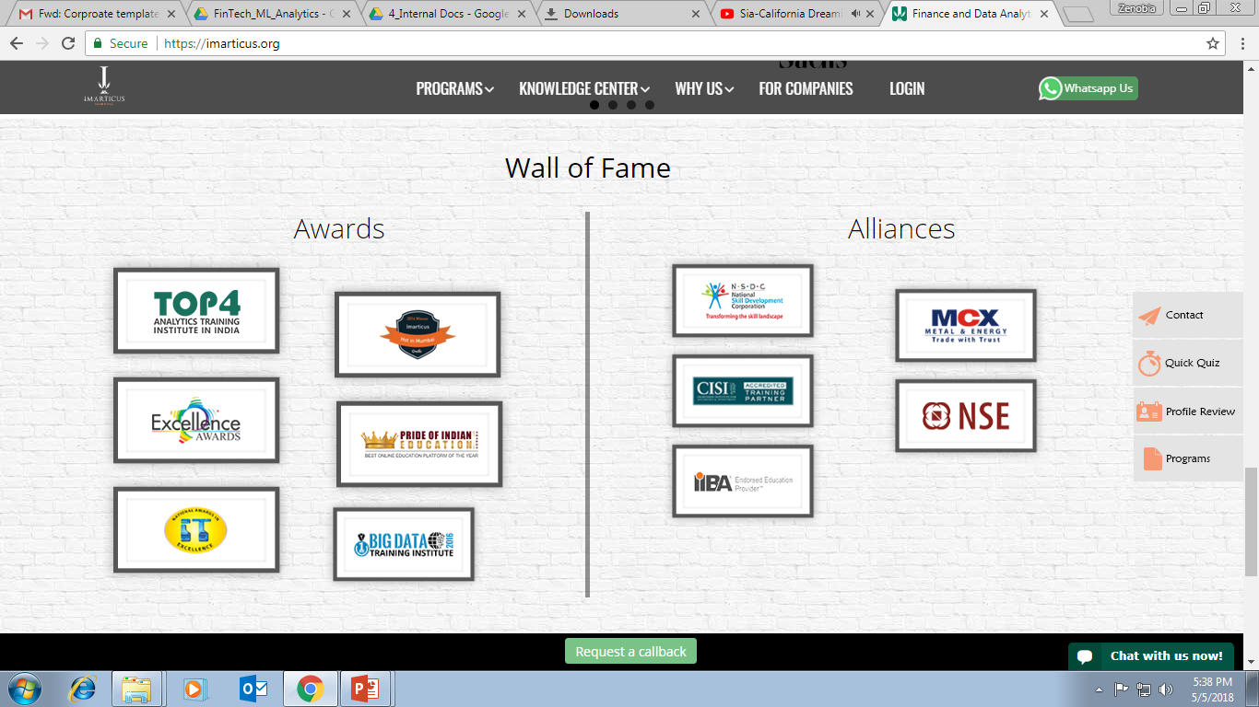



AWARDS:
Learn more:
https://imarticus.org/corporate/
Email us:
info@imarticus.com
Connect with us:
www.linkedin.com/company/imarticuslearning
ACCREDITED TRAINING PARTNER:
Watch us:
www.youtube.com/ImarticusLearninginstitute
Visit us:
Mumbai | Thane | Pune | Bangalore | Delhi - NCR | Hyderabad | Chennai | Coimbatore

